Slide 1
Compounds
Physical Science

Slide 3
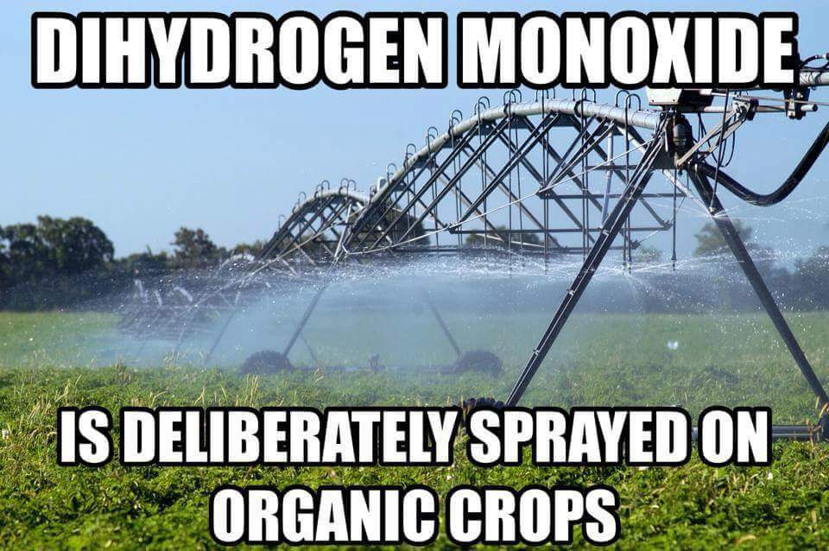

Slide 4
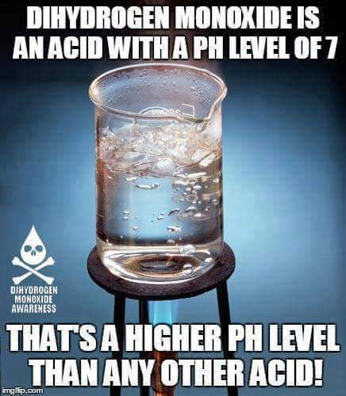

Slide 6
